Slide 1
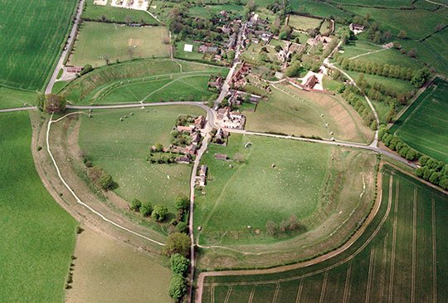
Avebury
Avebury is like stone henge.
Avebury is located in wiltshire England by LAYLA/connor

Slide 2
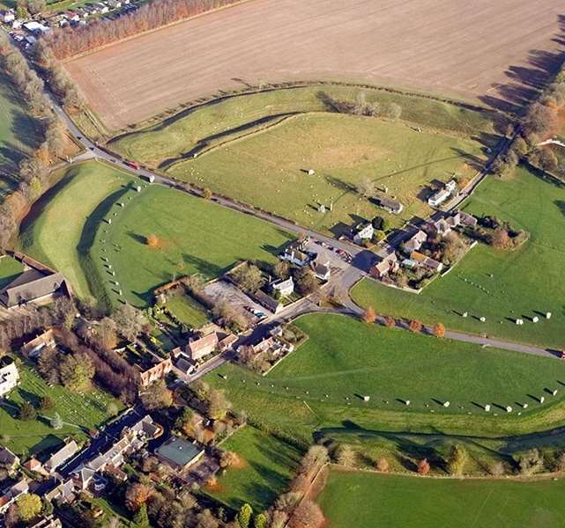
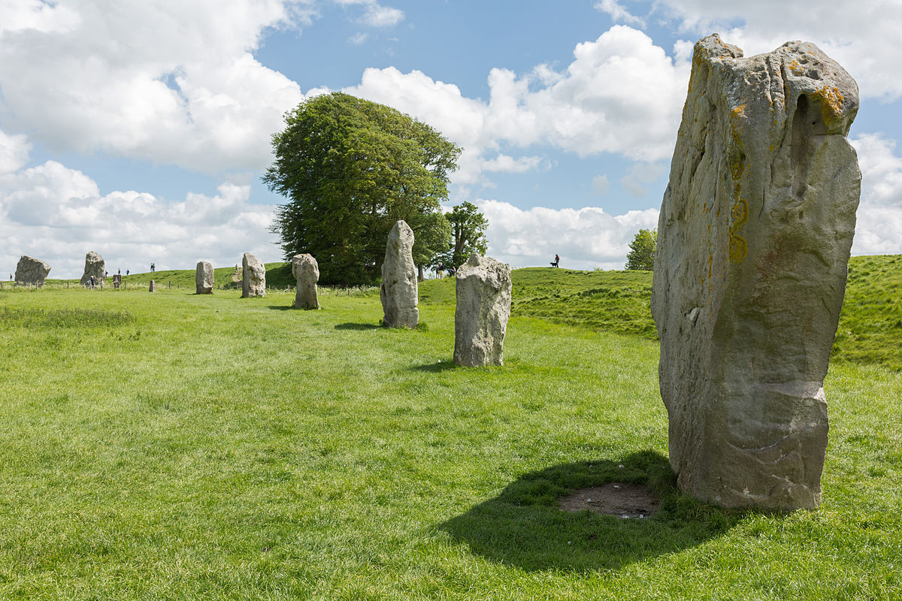
stones
In Avebury some stones have been taken to build houses.
The stones are very old and tall.
You would NOT come at the top.

Slide 3
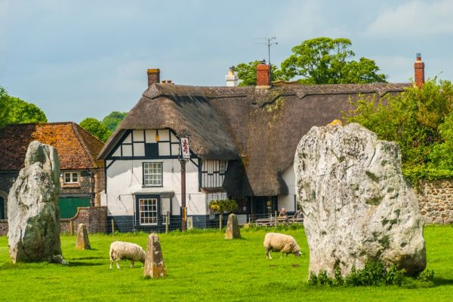
Stones arrival
Some off the stones came from miles a way.
They had to pull the stones with lots of string and poeple.

Slide 4
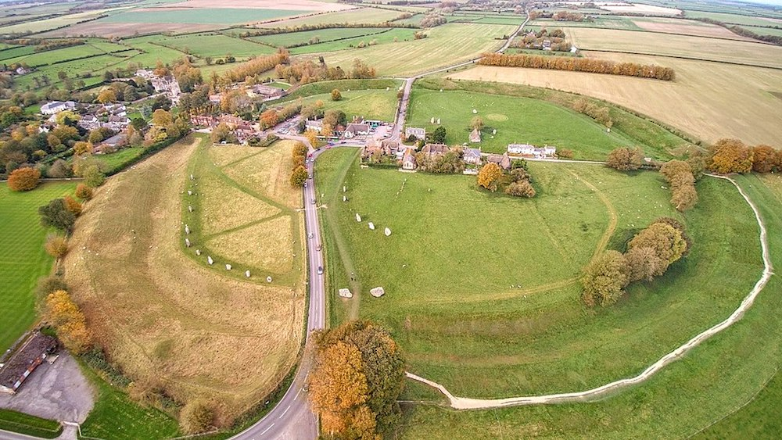
Finally
If you go to Avebury have fun and have a great time

